Slide 1
Conditions & Loops
(Week 3)
Name: Sheikh Thanbir Alam
Deg: Senior Software Programmer
Org: Army War Game Center, BD Army

Slide 2
Suggested IDE for C#
Visual Studio (Desktop/Laptop→Click to download)
Try Dot Net (Web→Click to view)
Dot Net Fiddle (Web→Click to view)

Slide 3
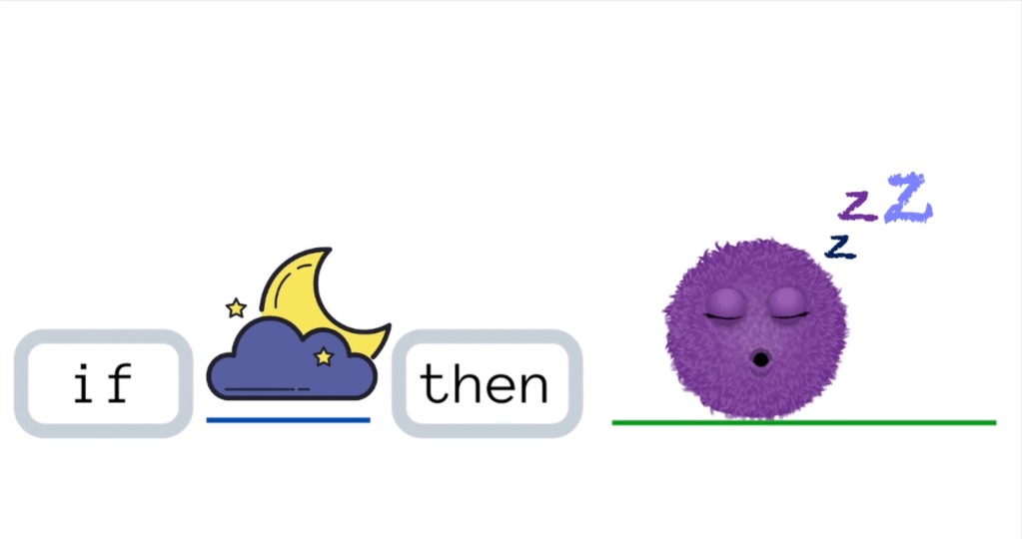

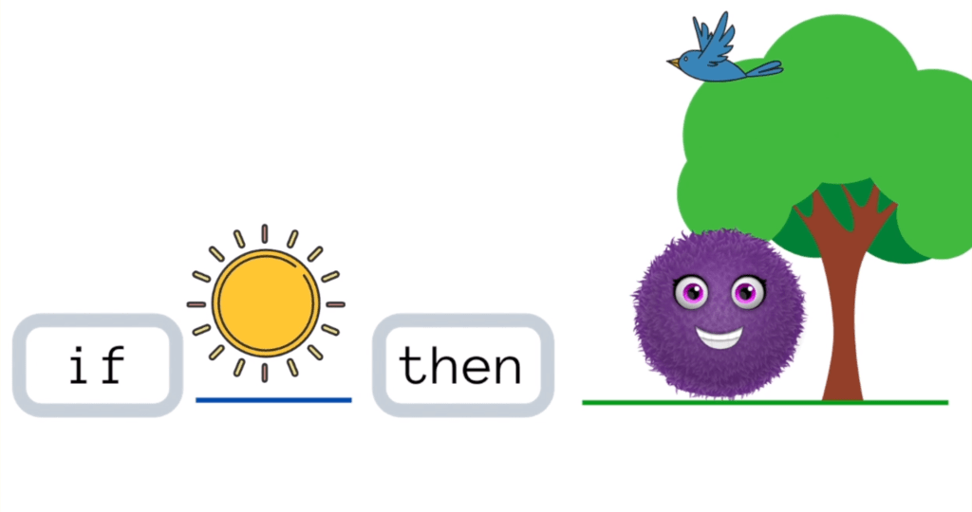
If Condition

Slide 4
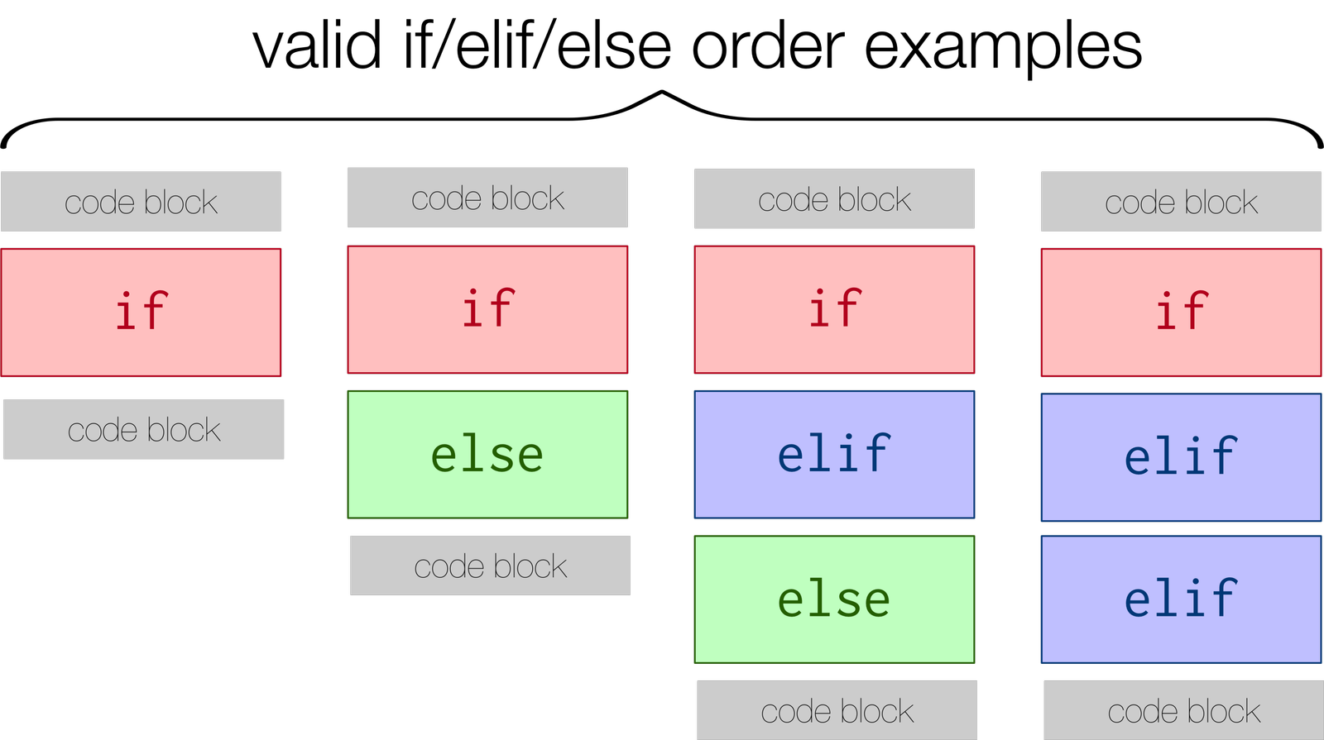
IF → ELSE; IF → ELSE IF → ElSE

Slide 5
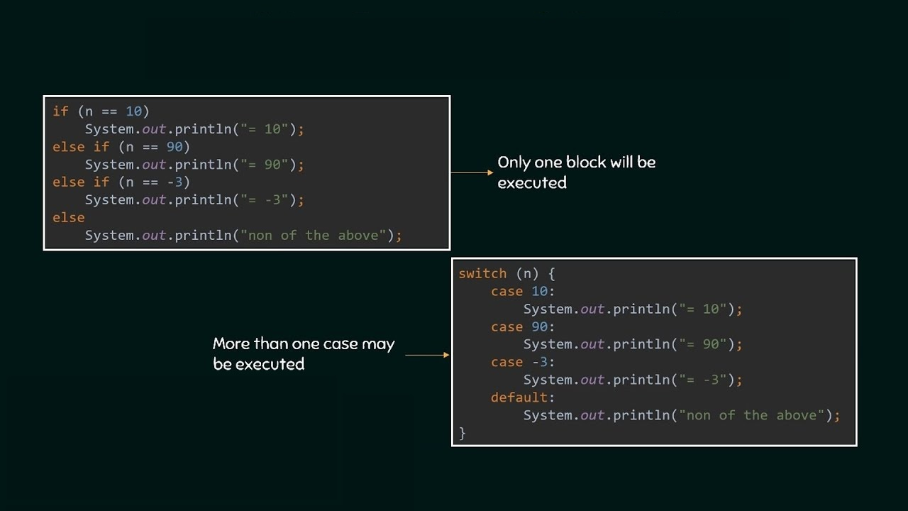
Switch Case

Slide 6

Practice
Take an integer number as input
Check it with a condition that is it bigger than 55 or not?

Slide 7


Loop

Slide 8
Loops in Programming
Why we need loop in programming?
Types of Loop:
For
Foreach
While
Do-While

Slide 9
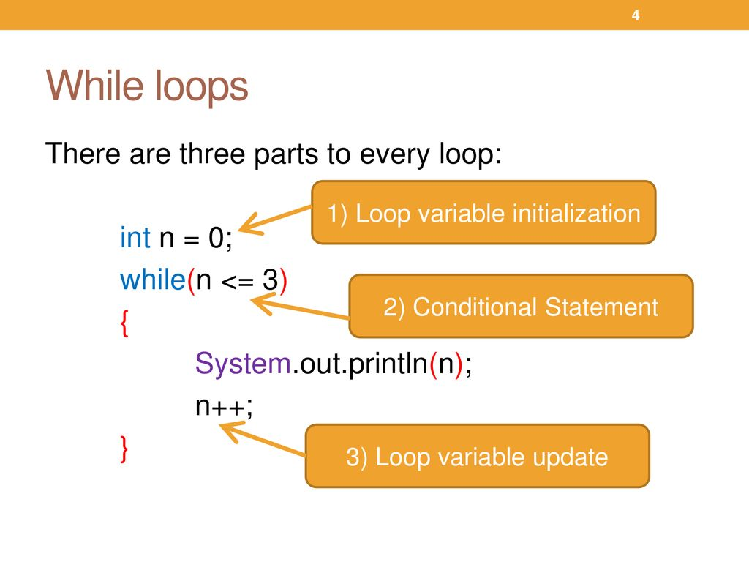

Slide 10
Practice
Print your name 5 times with while loop.
Print your friends name 9 times with while loop.
Print 1 - 20 with while loop. (H.W)

Slide 11
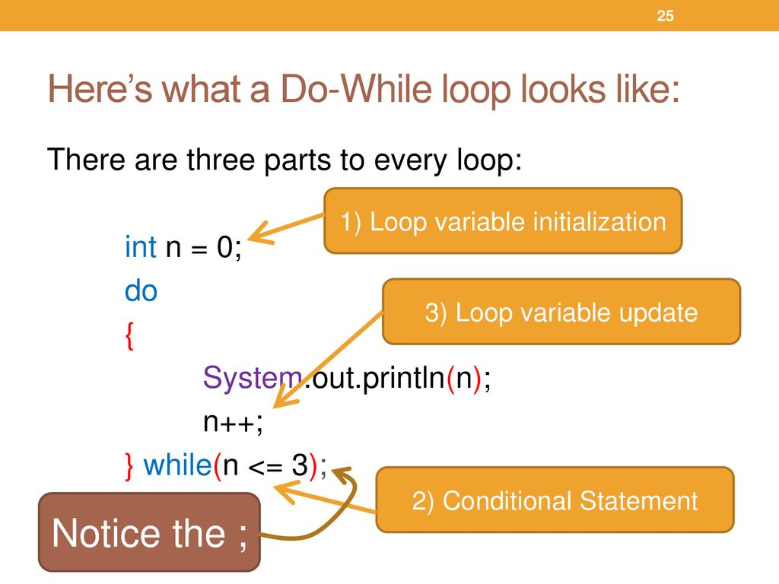

Slide 12
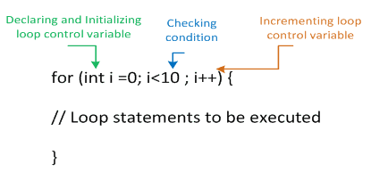
For Loop

Slide 13
Practice
Print your name 5 times with for loop.
Print your friends name 9 times with for loop.
Print 1 - 20 with for loop. (H.W)

Slide 14

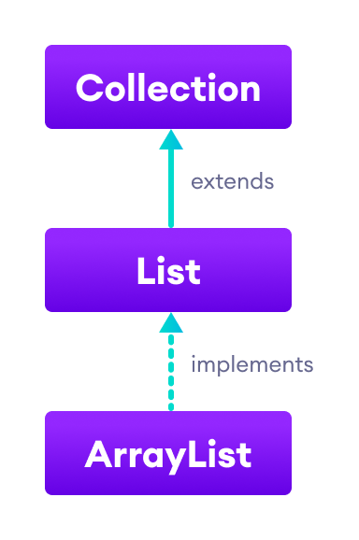
For Each Loop

Slide 15


